Slide 1


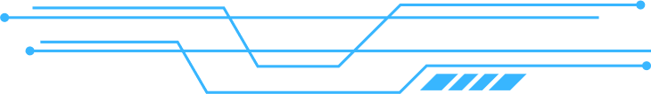

Text Summarizer & Question Answering Project

Slide 2

Introduction
• Project idea:
Take any long text (article, news, book section)
Summarize it into the main key points
Let the user ask questions and get direct answers

Slide 3

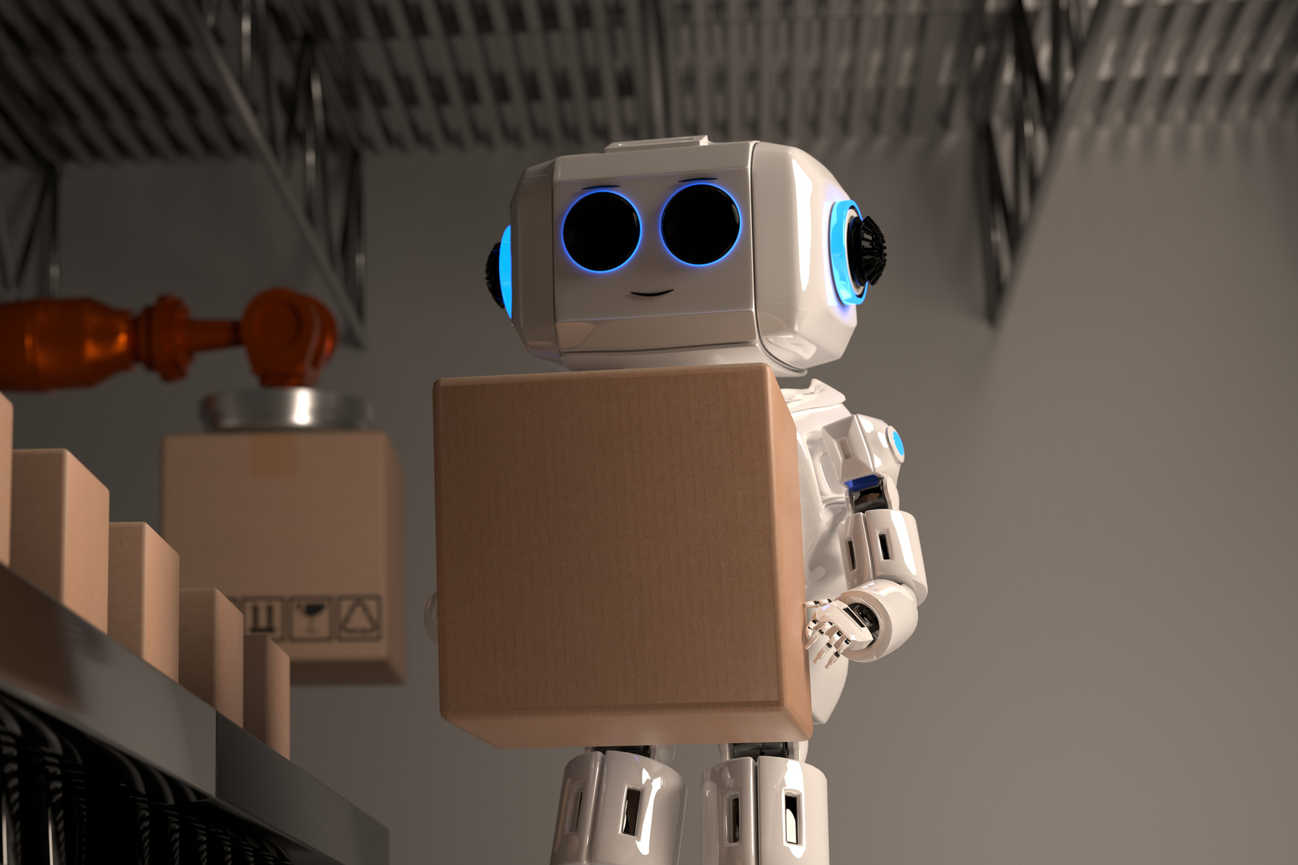
Tools & Technologies
• Python
• Hugging Face Transformers
• PyTorch
• Streamlit

Slide 4


Project Steps
1. Notebook Phase:
- Tested summarization and Q&A models
- Verified no errors
2. Streamlit App:
- Text input area
- Summarize button
- Question input
- Answer box

Slide 5

Text: 'The Great Wall of China...'
• Question: 'When was most of the Great Wall built?'
• Expected Output:
- Summary: Built mainly during Ming Dynasty, 21,000 km
- Answer: 'Most of the existing wall was built during Ming Dynasty (1368–1644)'
Demo Example

Slide 6
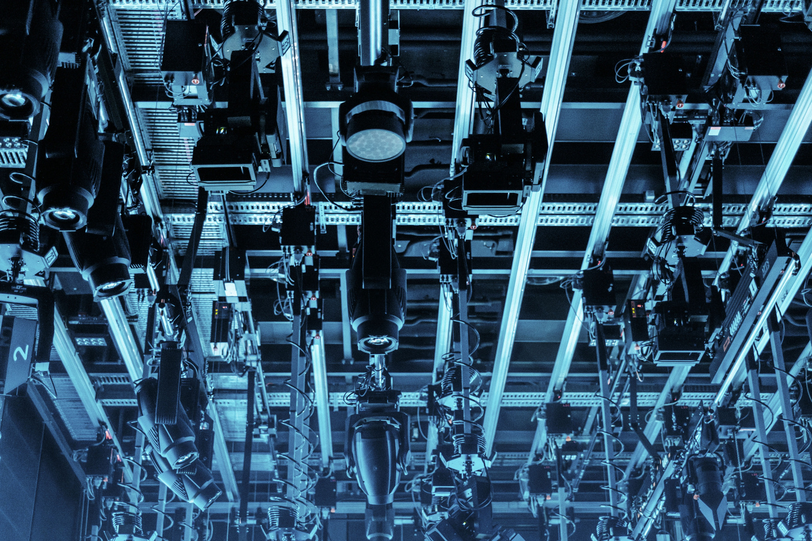

Challenges
Compatibility issue: Keras 3 with Transformers
- Solved by switching to PyTorch backend
• Handling long texts (splitting/truncation)

Slide 7
THANK YOU

